Slide 1
Practical – 4
Machine Learning

Slide 2
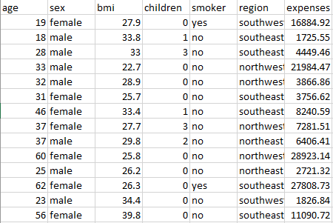
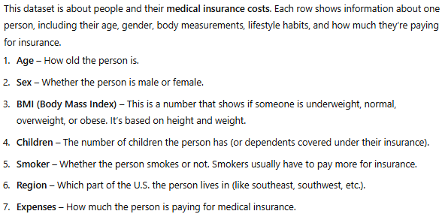
Aim:- Given an insurance dataset, predict the medical expenses for new input data (new person’s details).
We have 1,339 rows of data (i.e., 1,339 people), and each one has the same 7 details (or columns).

Slide 3
We have a dataset with details about people — like their age, gender, BMI, number of children, whether they smoke, where they live — and how much they pay for medical insurance.
Now, our goal is to predict the insurance cost for a new person, just by looking at their details.
Since what we want to predict is a number (the insurance cost), this becomes a regression problem. Regression simply means predicting numbers, like prices, heights, or weights — anything that’s continuous.
To start simple, we'll use a method called Linear Regression. But in our case, we’re not just using one input — we have several features like age, BMI, smoking status, and so on.
So it is a case of Multiple Linear Regression — it’s the same idea, just with more than one input.

Slide 4

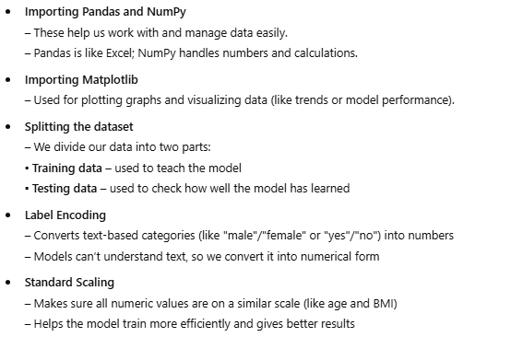


Slide 5
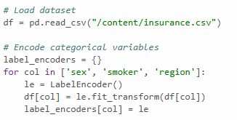

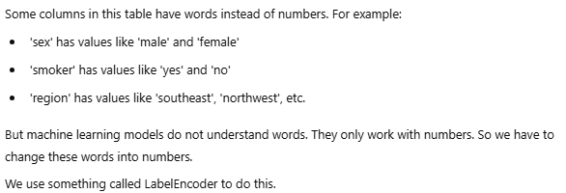
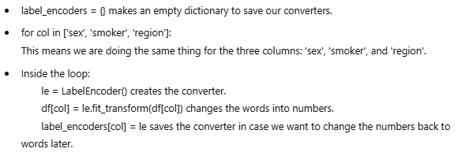

Slide 6

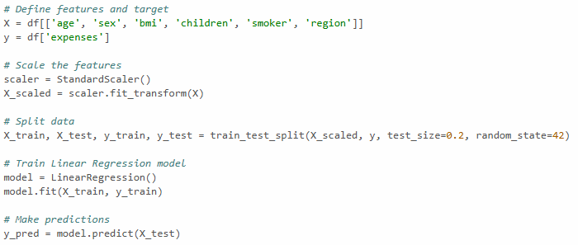


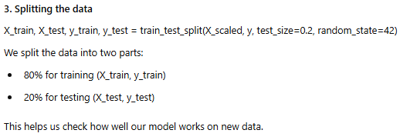


Slide 7
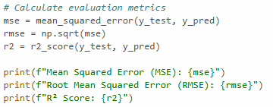


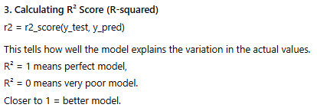
If it's a regression problem, we use metrics like MSE, RMSE, R², and MAE, but for classification problems (like using Decision Tree, KNN, or Logistic Regression), we use metrics like confusion matrix, accuracy, precision, recall, and F1 score — because both are different types of problems and need different ways to check performance.

Slide 8

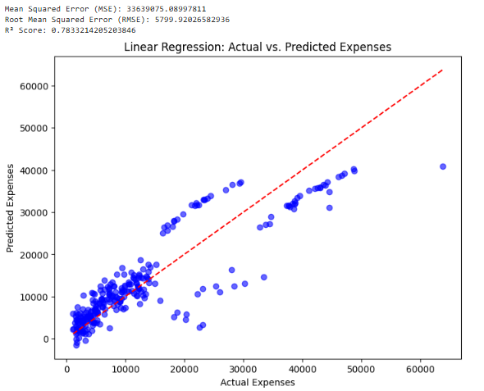
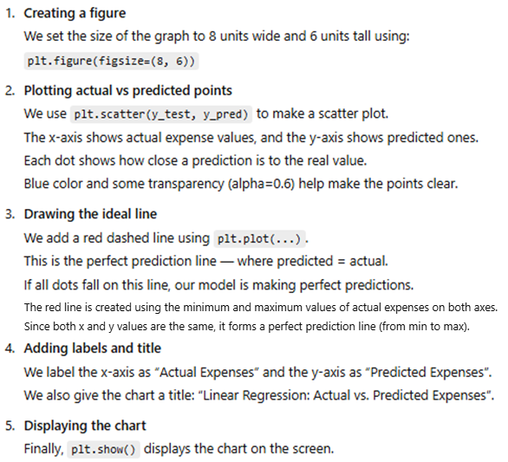

Slide 9
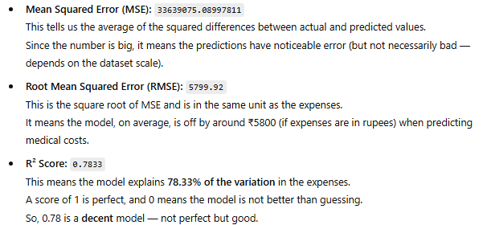


Slide 10

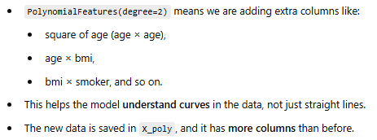
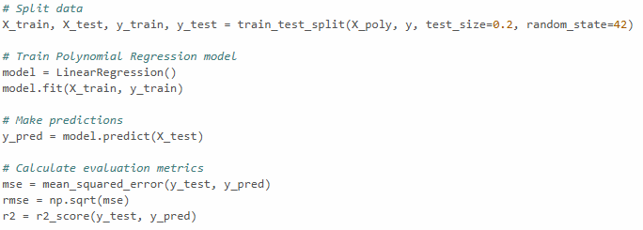
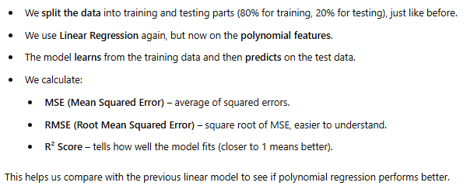
Lets check with polynomial regression:-

Slide 11

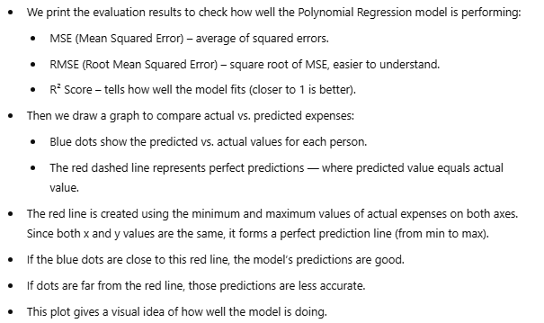

Slide 12
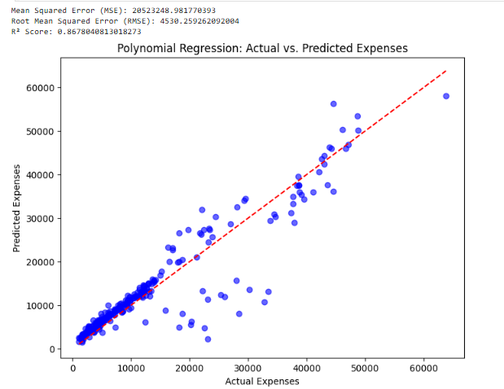

Slide 13



Slide 14
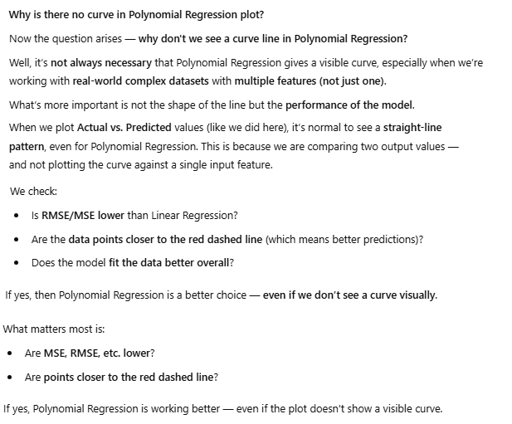

Slide 15


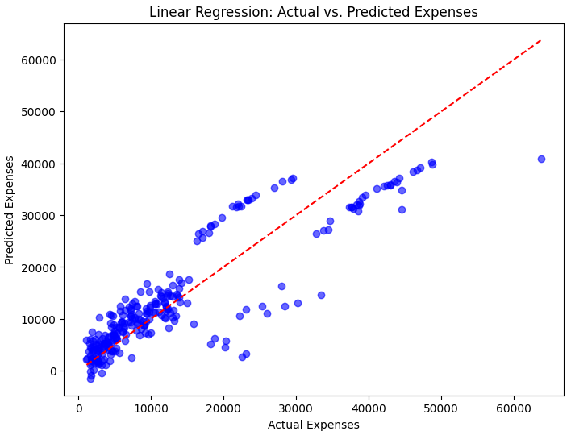
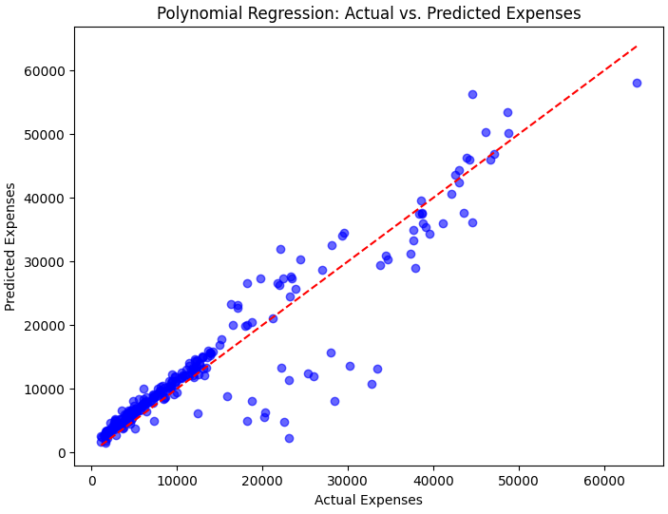

In this case,
We will select polynomial regression for prediction of new feature.

Slide 16
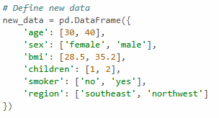



Slide 17



Slide 18



Slide 19


